Slide 1
Validation of a given csv file
Guide Name:
Mr.S.David Samuel Azaiya
Done By:
-Meena.S
-Mounisha.R
-Muskan Saraf

Slide 2
abstract
* CSV looks easy, but it can be hard to make a CSV file that other people can read easily.
* Invalid CSV files create challenges for those building data pipelines.
* Pipelines value consistency, predictability, and testability as they ensure uninterrupted operation from source to a target destination.
* Thus in this project we will get a csv file from the user with name, age, phone number, email id and create the records, validation of data, filter the duplicate records and check what has to be used in the date type and for null value.
* Through this the CSV file could become more definite.

Slide 3
Software and hardware requirement
Hardware
Processor: Intel core i3
Memory: 4GB RAM
Storage: 194 GB
Software
Language: Python
Libraries: numpy, pandas
Module: CSV

Slide 4
CSV file (comma-separated values file)
The spreadsheet is a very popular, and powerful, application for manipulating data.
Its popularity means there are many companies that provide their own version of the spreadsheet.
It is a text format, accessible to all apps.
Each line (even if blank) is a row.
In each row, each value is separated from the others by a comma (even if it is blank).
Cannot capture complex things like formula.

Slide 5
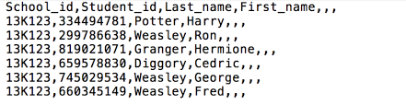
Spread sheet and corresponding CSV file
School_id | Student_id | Last_name | First_name
13k123 | 334494781 | potter | Harry
13k123 | 299786638 | Wesley | Ron
13k123 | 819021071 | Granger | Hermione
13k123 | 65978830 | digger | Cedric

Slide 6
CSV format
As simple as that sounds, even CSV format is not completely universal ,different apps have small variations.
Python provides a module to deal with these variations called the csv module.
This module allows you to read spreadsheet info into your program.
We load the module in the usual way using import:
>>> IMPORT CSV

Slide 7
FUNCTIONAL MODULE
GET THE CSV FILE FROM USER THROUGH A HTML PAGE
READ THE GIVEN FILE AND CHECK FOR FOLLOWING FUCIONS
LABEL ENCODING
DATA TYPE PREDICTION
PREDICTING DUPLICATE VALUE
CHECK FOR NULL VALUE
IF YES THEN ALSO CHECK FOR ONEHOT ENCODING AND FEATURE SCALING
ALL THE CHANGES ARE SAVED IN THE FILE AND USER CAN GET THE FILE FROM VALIDATE FOLDER

Slide 8
Block diagram
RAW DATA
CSV FILE
APPLICATION UNDER TESTING
VARIOUS USAGE OF DATASET
PROCESSED DATA

Slide 9
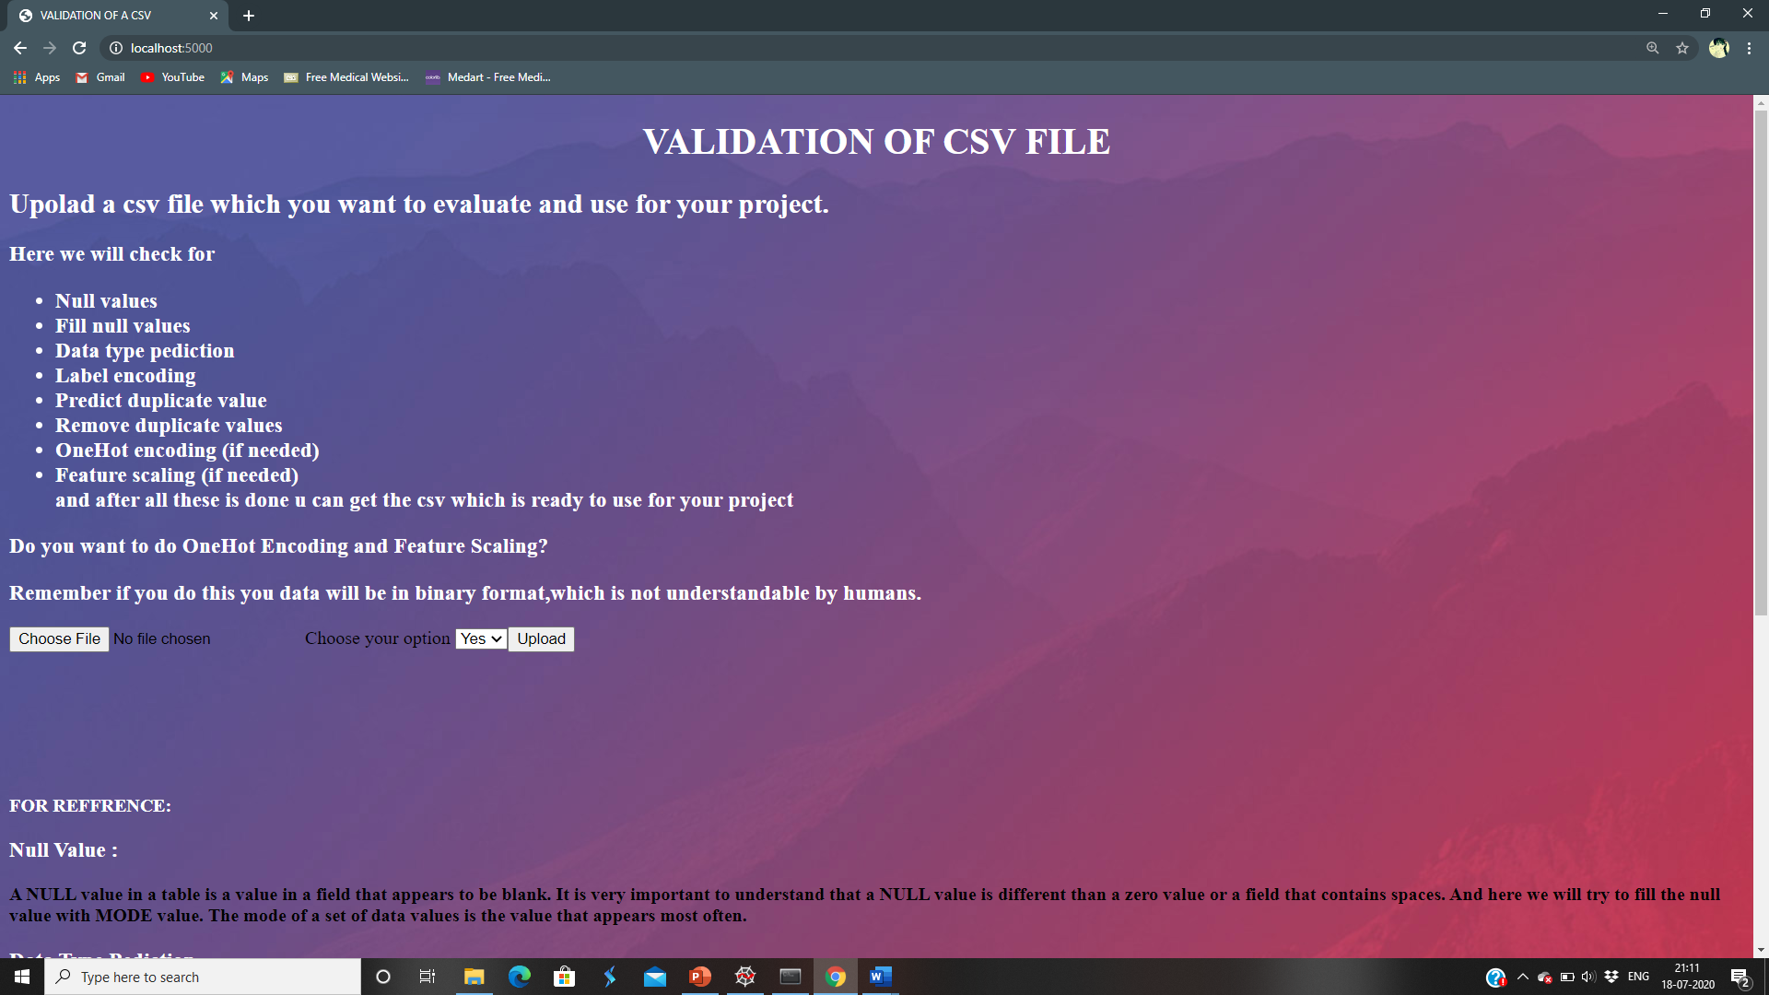
User interface: Flask

Slide 10
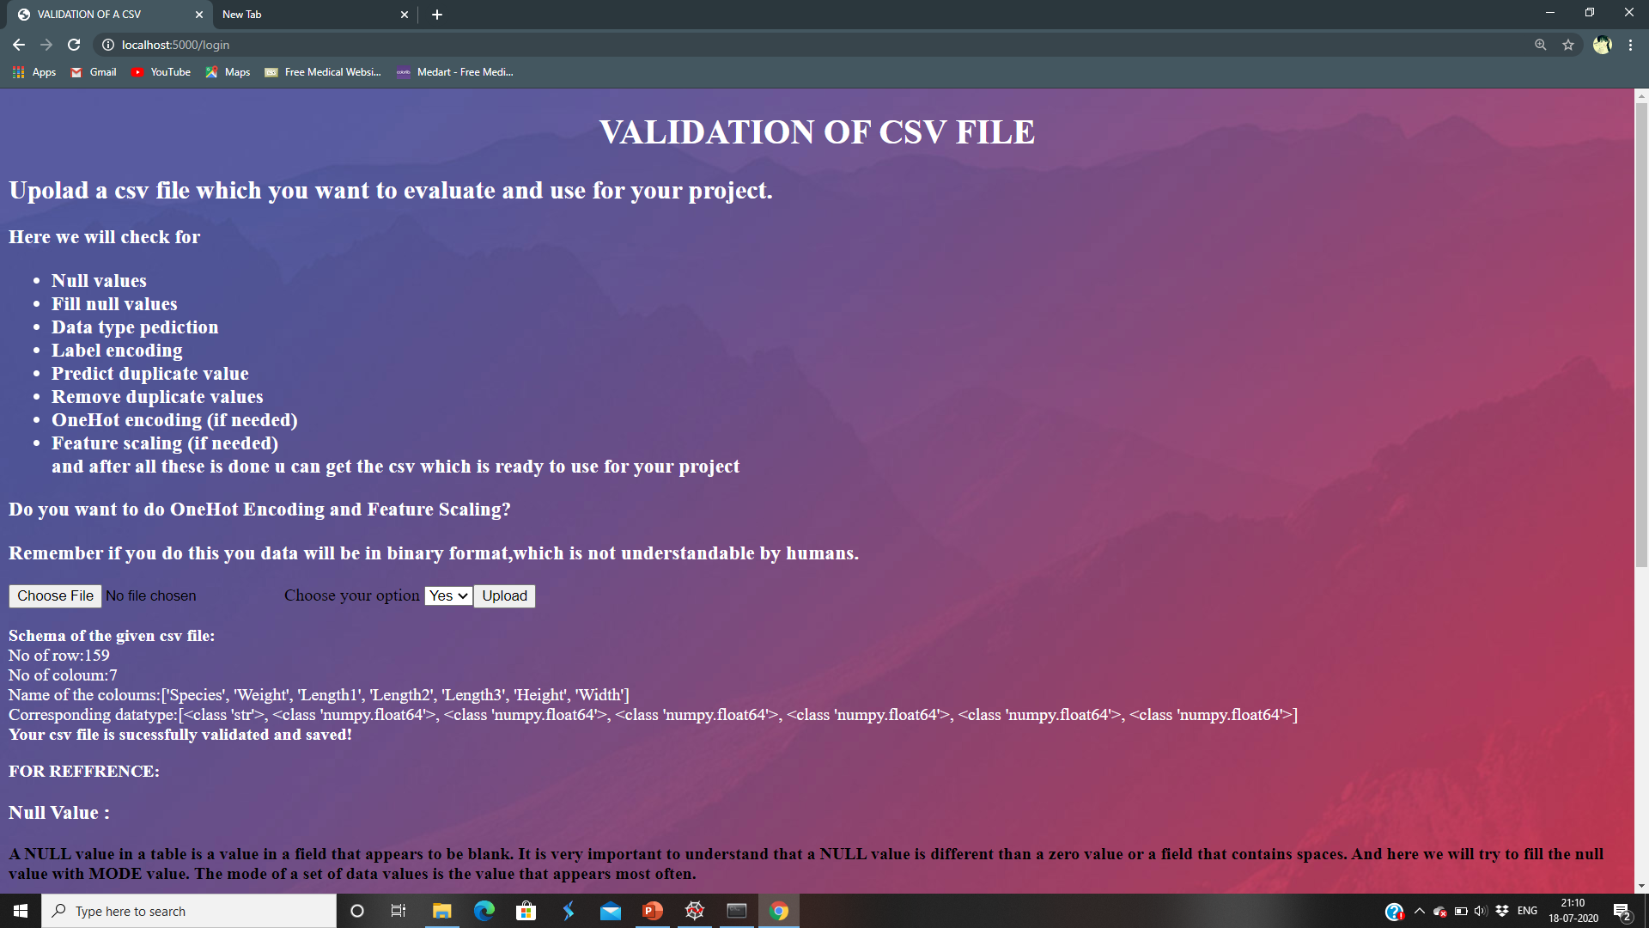

Slide 11
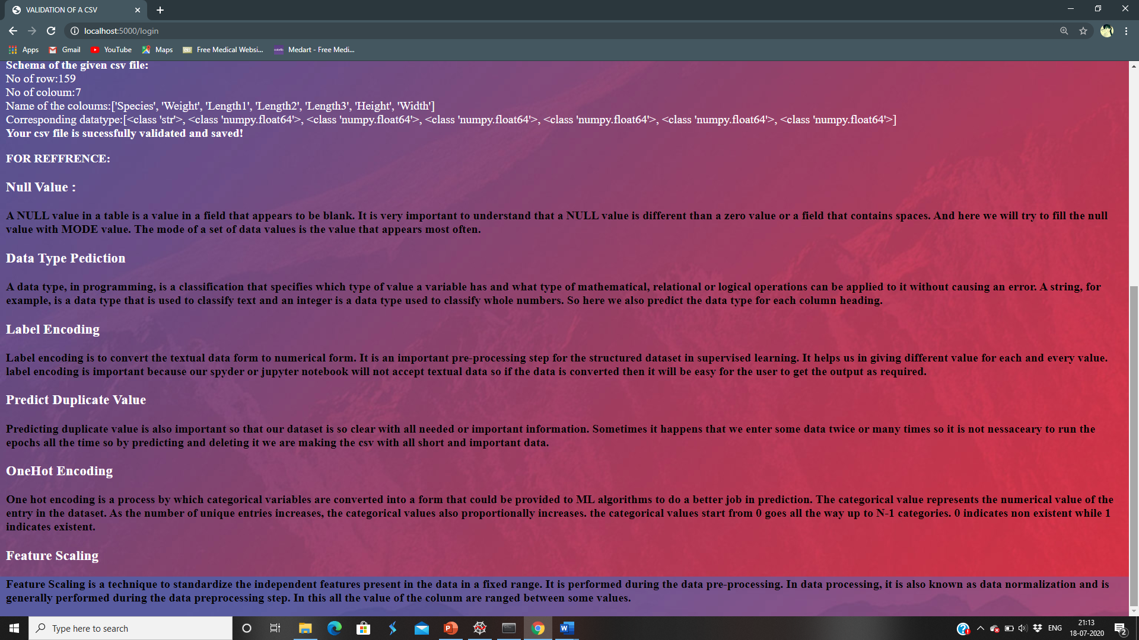

Slide 12
THANK YOU

